Slide 1
VEHICLE INSURANCE SYSTEM
Project Members :
Ms . shivamma
Mr . Mohit.G
Ms . Pavithra.S
Ms . Devika.L
Ms . Preethi.R
Mr . Vasanth Kumar
Guided By :
Prof. Indrakka Mali​​

Slide 2
Contents :
Introduction
ER Diagram
Working of Back-End
Working of front-end
Annotations
APIs
Software Requirement
Features Of System
Conclusion

Slide 3
Introduction :
The Vehicle Insurance System is a Web Application developed using spring boot and Structured Query Language as backend and Angular as frontend.
The Goal of the application is to provide a dashboard to the insurance company where they can keep track of their customers.
The vehicle insurance system is used to store customer details like customer id , name , phone number , Aadhar number , pan number , Driving license number and customer’s vehicle details.

Slide 4
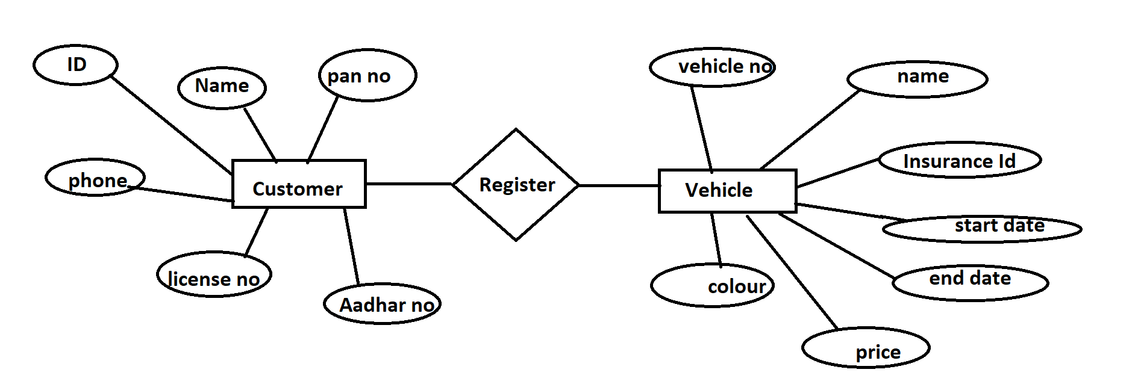
ER DIAGRAM

Slide 5
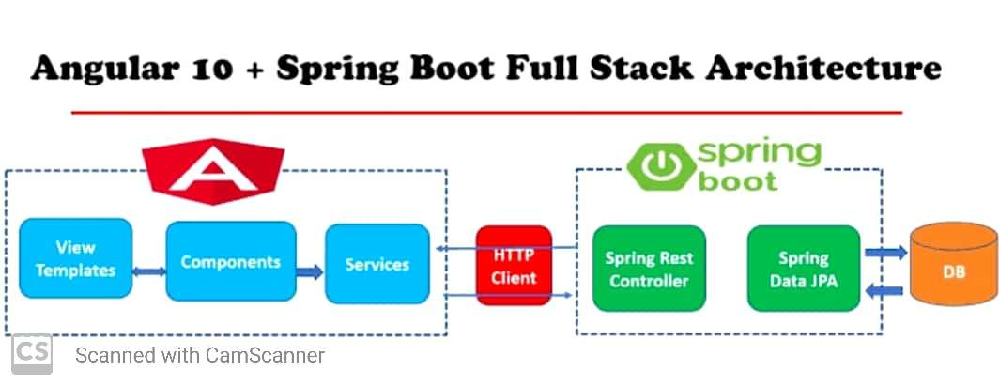
WORKING OF FRONT-END

Slide 6
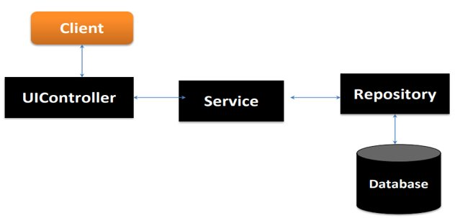
Working Of Back-End :
There are mainly three stages

Slide 7
Working of Front-EnD
Once we deployed our application on the server , a customer and vehicle
registration form generates at the web browser . The form facilitates to add
and view customer and vehicle details.
On clicking add customer , the page redirects to create customer and
vehicle form where we can add customer and vehicle by filling the required
details and submit them.
We can update and details the details of the customer and student . Once
completed , provide the URL http://localhost:4200/ at the web browser .

Slide 8
Work Flow :
Client send a request to server for different options like inserting ,fetching ,update and delete a data.
When client hit on request .Request goes to the Controller Class and use respective URL to take data.
Then control of URL goes to the service Class And Conditions get Executed.
For returning response to client use same sequence. Service To Controller Class.
Here Repository class is used to interact with database using Hibernate Technology.

Slide 9
Annotations (@) :
Annotations are used to provide supplemental information
about a program.
Annotations start with ‘@’.
@Id : This id annotation is used to declare attribute as primary key.
@GeneratedValue : Used to generate value automatically when user insert new record in table.
3. @Column : Adding the column the name in the table of
particular MySQL database.

Slide 10
4. @Email : used to compare email format ​.​
5. @size : Used in collection. ​
6. @NotNull : This gives mandatory filed to enter data.​
7. @OneToOne : To create the One-to-one relationship between the Customer and vehicle class.​
8. @JoinColumn : helps us specify the column we'll use for joining.
9. @JsonIgnore : Is used to ignore the logical property used in serialization and deserialization.​
10. @Entity : is used is used to mark this class as an Entity bean.​
​

Slide 11
11. Cascadetype.All : ensure that all persistence events such as persist, refresh, merge and remove that occur on the parent, will be passed to the child.​
12. @override : Informs the compiler that the element is meant to override an element declared in a superclass.​
13. @RestController : This annotation is used at the class level and allows the class to handle the requests made by the client.​
14. @Autowired : Enables you to inject the object dependency implicitly.​

Slide 12
15. @ControllerAdvice : Allows to handle exceptions across the whole application in one global handling component.​
16. @ResponseStatus : To mark a method or an exception class with a status code and reason that should be returned.​
17. @ExceptionaHandler : Used to handle the specific exceptions and sending the custom responses to the client.​
18. @Service : It is used to mark the class as a service provider
19. @Max : Max is used to validation to show the max value.
20. @Repository : Repository is used in repository class.

Slide 13
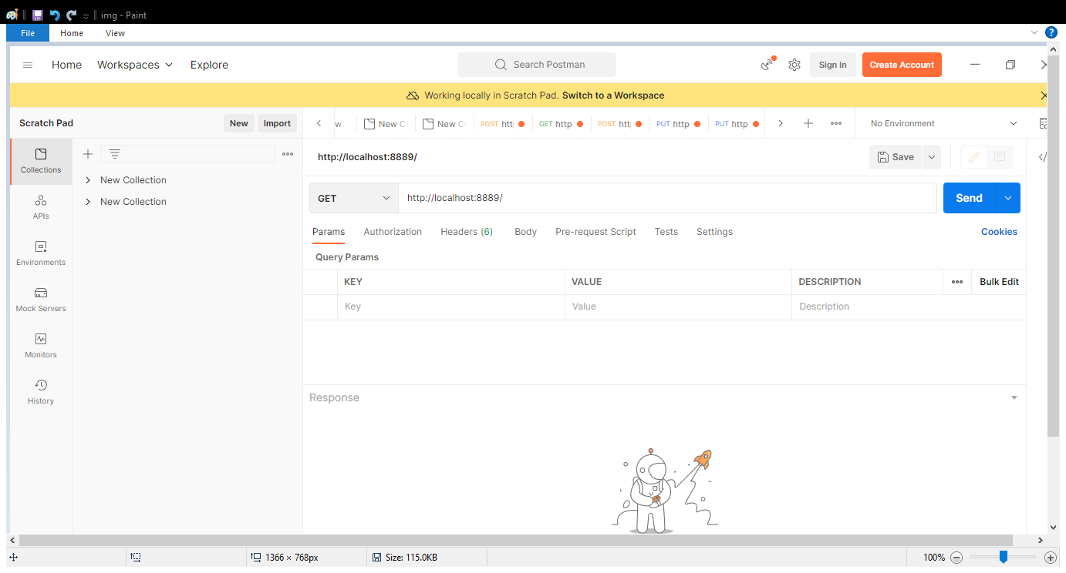
Application Programming Interface(APIs);
APIS Under Director To Do :
“customer/all/” : Direct can access all customer details using this URL.

Slide 14
CUSTOMER URL:
1. “post/customer” : To add the customer details in table.
2. “get/customers” : we can get all customer record which is in customer table.
3. “delete/customer/cid” :​ It is used to delete particular record in table to use customerid.
4. “put/customer/cid” : It is to update particular customer by customerid.
“get/customer/cid” : This url is to get a particular customer by using customerid.
6. “put/customerAssignVehicle/cusid/vehicle/insid” : It used to get
Customer details and their appropriate vehicle details using id.

Slide 15
Vehicle URL :
“post/vehicle” : It used for for to add vehicles in table.
“get/All vehicles” : This url for getting all vehicle records from the table.
“delete/vehicles/vleid” : Its for deleted particular record in the table.
“put/vehicles/vleid” : Its for update a particular vehicle in existing table.

Slide 16
Software & hardware used :
Software Requirements :
Operating System : Windows 10, 11
Language : Java
IDE : Spring Tool Suite
Client : Postman
Backend : MySQL
Frontend : Angular js
Hardware Requirements :
CPU : Intel Pentium V processor
RAM : 6 GB or above
Hard Disk : 64 GB hard disk space or minimum

Slide 17
Conclusion :
The project entitled as Vehicle Insurance System is the system that deals with the registration for customer’s vehicle insurance
This project is successfully implemented with all the features mentioned in system requirements specification.
It provides protection in case of third-party liability along with a cover against damages to the insured vehicle or injuries caused to the owner or driver
Along with this, comprehensive motor insurance protects your car from various damages caused due to riots, vandalism, natural disasters, theft, etc.

Slide 18


